Slide 1
A road pavement monitoring system for anomaly detection using smart phones
Keyword: Engineering, Road Monitor, Smartphone, Machine learning
王镇 2019/6/1

Slide 2
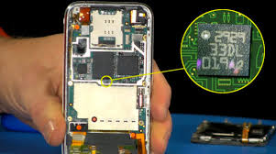
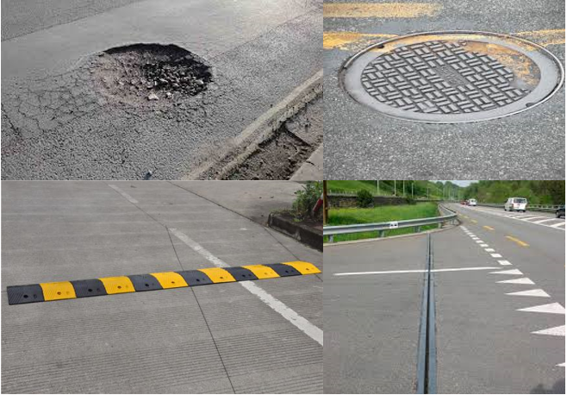
Introduction
Road Monitoring Using Smartphones:
utilize sensors equipped in smartphones to detect road surface anomalies
Sensors：
Accelerometer
Gyroscope(陀螺仪)
GPS
Road surface anomalies:
Potholes and cracks
Manholes
Speed bumps
Road joints
Significance？
Advantage??

Slide 3
Introduction
Main jobs of the paper:
Experiments
Collect data
Data
Preprocessing, Processing, Extract
Features
Training
Detector
A RoADS system=smart phone + car
Accuracy of ≈ 90% on detecting severe anomalies

Slide 4
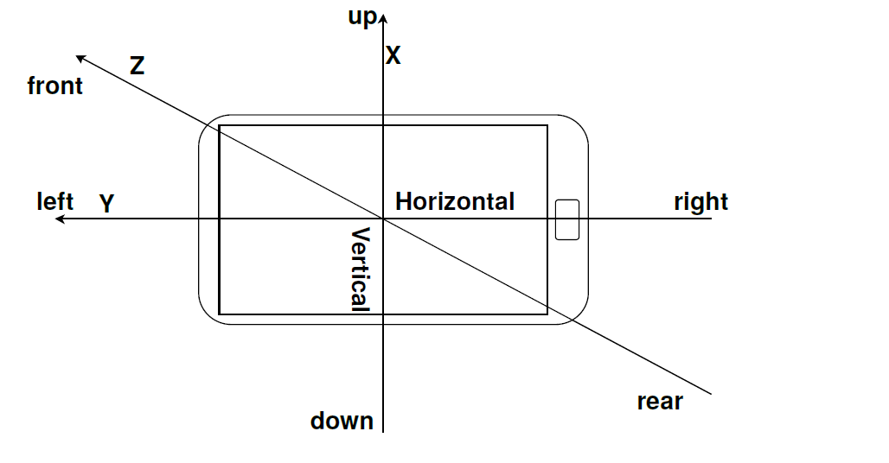
Experiment design
Smartphones: Samsung Galaxy S2
Placement: fixed on windshield(挡风玻璃)
Sensors used:
Accelerometor, detect vibration
GPS, detect position
Gyroscope, differentiate anomalies that spanning the road and potholes
Sampling rate: 47Hz, 93Hz
City of the detected road: Vlora in Albania, Enschede in Netherlands
Smartphone orientation inside the car

Slide 5
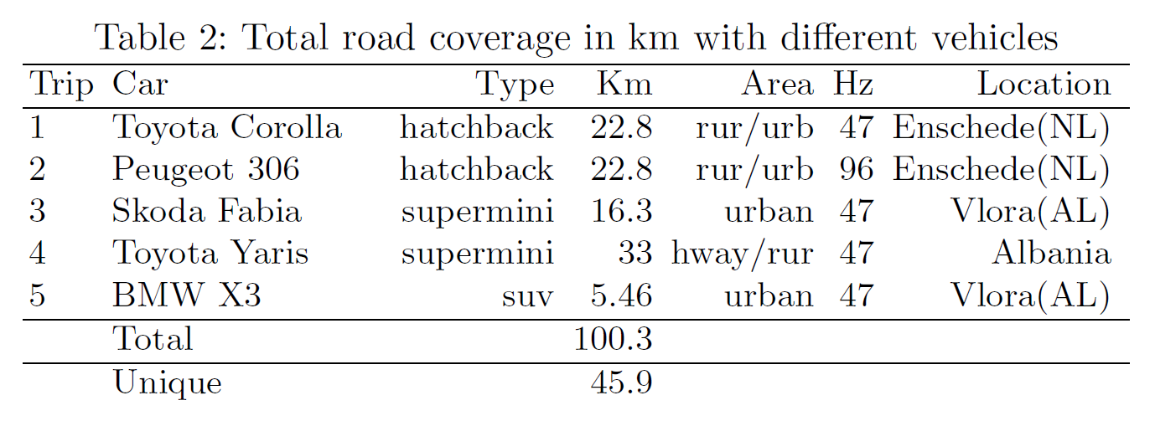
Data collection

Slide 6
Data labelling
Multiple times over the same road segment, every time with different speed and tried to hit the anomaly in different angles.
Labelling by the microphone and the camera of the phone.
The anomalous data were divided into 3 event classes:
Severe, in this category we labelled sunk-in manholes, small potholes and deteriorated and heavily patched road segments.
Mild, in this category we placed all those anomalies that happened only in one side of the car such as cracks, one side patches, one side bumps.
Span, in this category were placed road-wide (transversal) bumps, road expansion joins, patches across the road, thick paint, bumps across the road and speed humps.

Slide 7
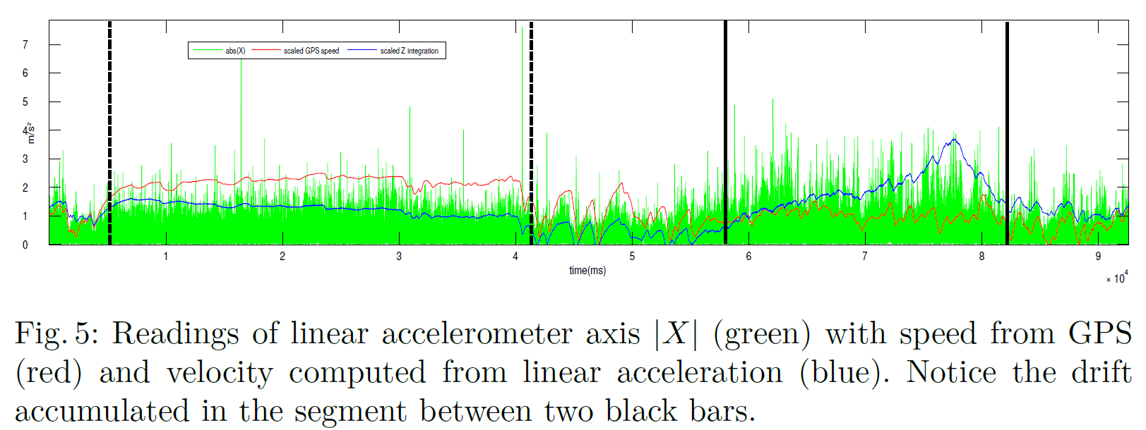
Dealing with speed
Speed dependency: while driving with different speeds over the same anomaly on the road, the signal has different peaks.

Slide 8
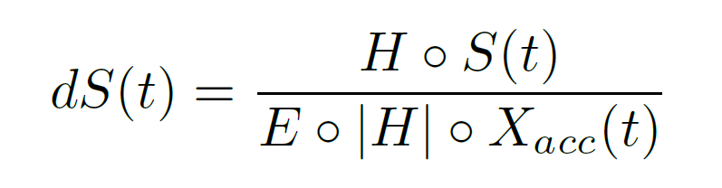
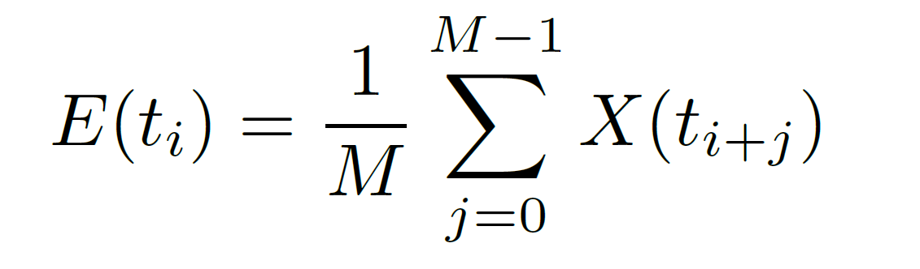
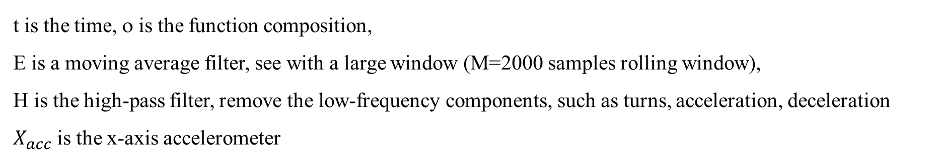
Deal with speed
How to remove effects of vehicles’ speed ?
Idea: the resemblance with radio technology
Answer: envelope demodulation(解调)
the accelerometer signal measuring complex mechanical vibrations
Demodulated signal dS is computed from the raw signal S based on equation:
t is the time, ο is the function composition,
E is a moving average filter, see with a large window (M=2000 samples rolling window),
H is the high-pass filter, remove the low-frequency components, such as turns, acceleration, deceleration
$X_{acc}$is the x-axis accelerometer

Slide 9
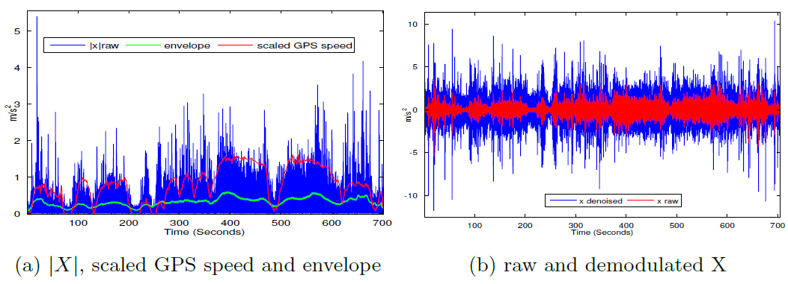
Deal with speed

Slide 10
Feature extraction
Windows set
Sampling rate | Number of samples | Samples overlap | Overlaping rate
93Hz | 256 | 170 | 66.4%
47Hz | 128 | 85 | 66.4%
Feature sets
Feature sets | Transformation | Features extracted
Time domain | None | mean, standard deviation, variance, peak to peak, root mean square, etc.
Frequence domain | FFT | mean frequency, median frequency, energy of the frequency bands.
Wavelet decomposition | SWT | absolute mean, standard deviation, variance, energy for every level of detail and approximation
FFT: Fast Fourier Transformation(快速傅里叶变换) SWT: Stationary Wavelet Transform(平稳小波变换)

Slide 11
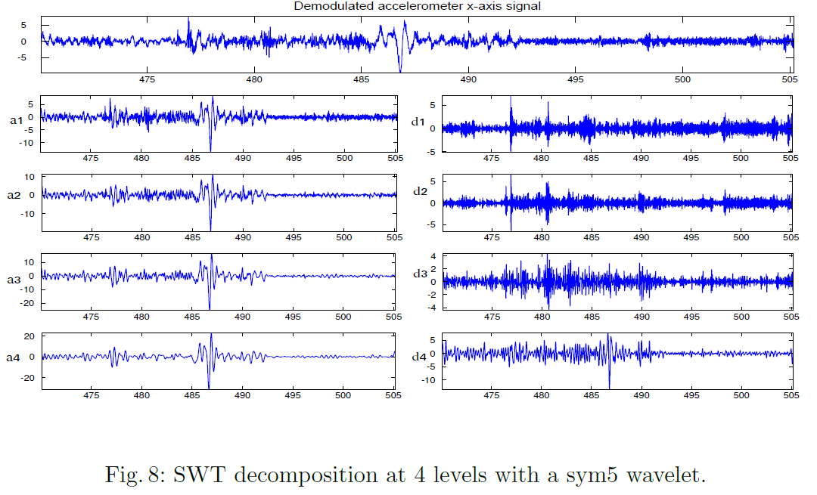
SWT

Slide 12
Classification using SVM
The method of classification: support vector machines (SVM)
First step: differentiate the anomalous windows from all the windows
Second step: classify the type of anomaly(severe, mild, span)
Experiments: training the detector with feature sets from different domains, transformations and combinations. Labelled data consisting of 3066 windows, 2073 normal windows and 993 anomalous windows in total were used, where 1/10 of both anomalies and normal data were used only for testing purpose.

Slide 13
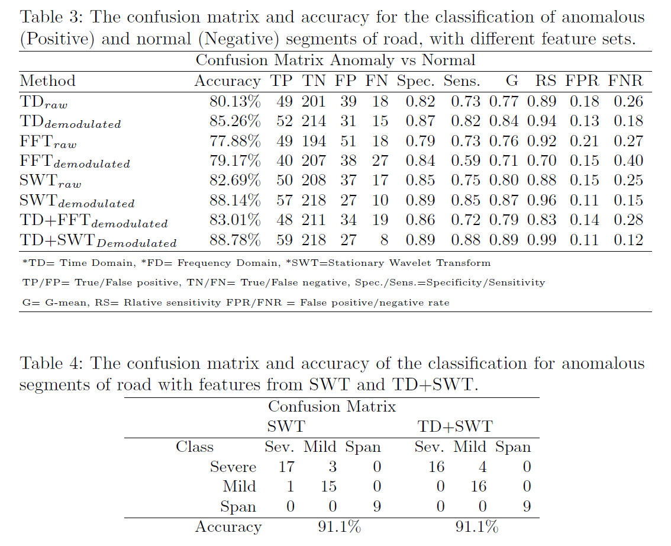
Results from training

Slide 14
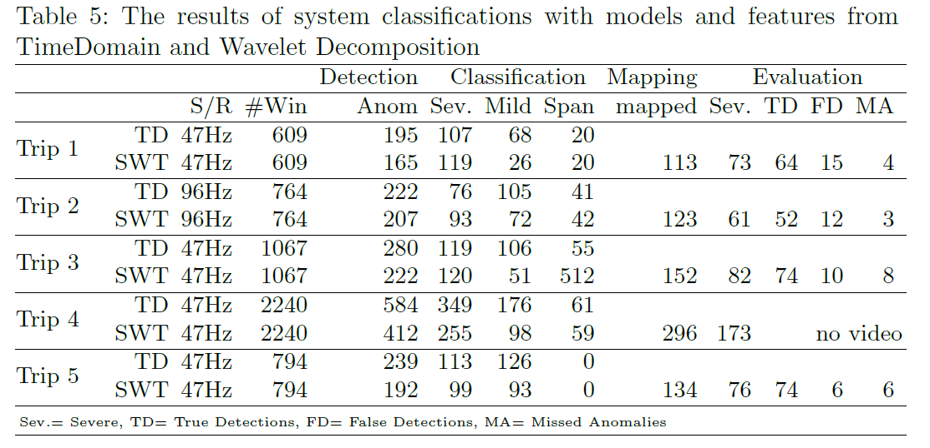
Results on unlabelled data

Slide 15
Conclusions
This paper proposed a system that detects road surface anomalies using mobile phones equipped with inertial sensors: accelerometers and gyroscopes.
Weakness: the orientation of smartphones is fixed, thus it cannot be popularized among crowdsource
to collect infinite data
Something worth learning:
The way to remove effects of vehicles’ speeds
The way of setting windows to extract features
High-pass filter and stationary wavelet transform to remove effects of vehicle condition

Slide 16
Thank You For Listening

